Slide 1
ACROPOLIS INSTITUTE OF TECHNOLOGY AND RESEARCH
SENTIMENT ANALYSIS
SUBMITTED BY:
Abhishek Raikwar 06
Aditi Bais 07
Aishwarya Borgaonkar 09
Amisha Mishra 14
Divya Kothari 32
Submitted to:
Prof.Gaurav Mandloi

Slide 2
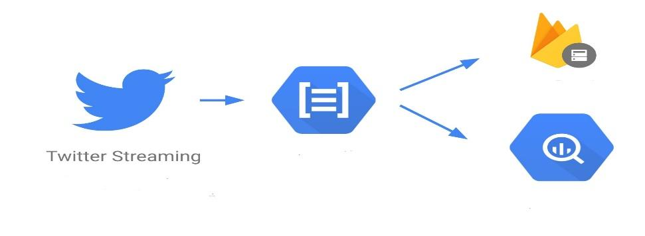
Sentimanalysis (also known as opinion mining) refers to the use of natural language processing, text analysis and computational linguistics to identify and extract subjective information in source materials.
INTRODUCTION

Slide 3
WHY SENTIMENT ANALYSIS?
Consumers can use sentiment analysis to research products and services before a purchase. Production companies can use the public opinion to determine acceptance of their products and the public demand. Movie-goers can decide whether to watch a movie or not after going through other people’s review sent. Analyzing the public sentiment is important to find out the response of the people across the globe, predicting political elections and predicting socioeconomic conditions, weather conditions making it feasible for a person to understand the situation in a location.

Slide 4
SCOPE
By investigating and analyzing customer sentiments, these brands are able to get an inside look at consumer behaviors and, ultimately, better serve their audiences with the products, services and experiences they offer.So we can attempt to perform separate sentiment analysis on tweets that only belong to one of these classes (i.e. the training data would not be general but specific to one of these categories) and compare the results we get if we apply general sentiment analysis on it instead.

Slide 5
ADVANTAGES
Economic : The proposed system is economic as it will be free till 1 million tweets.
Real-Time Observation : Live twitter streams of data is used to achieve higher accuracy.
Man Power : It does not require any person or their efforts.
Saved tweets: The data analysed is saved for further future use.
Representation : Percentage as well as pie chart representation is available.
Multiple polarity: The categories include- positive, strongly positive, weakly positive, neutral, weakly negative,

Slide 6
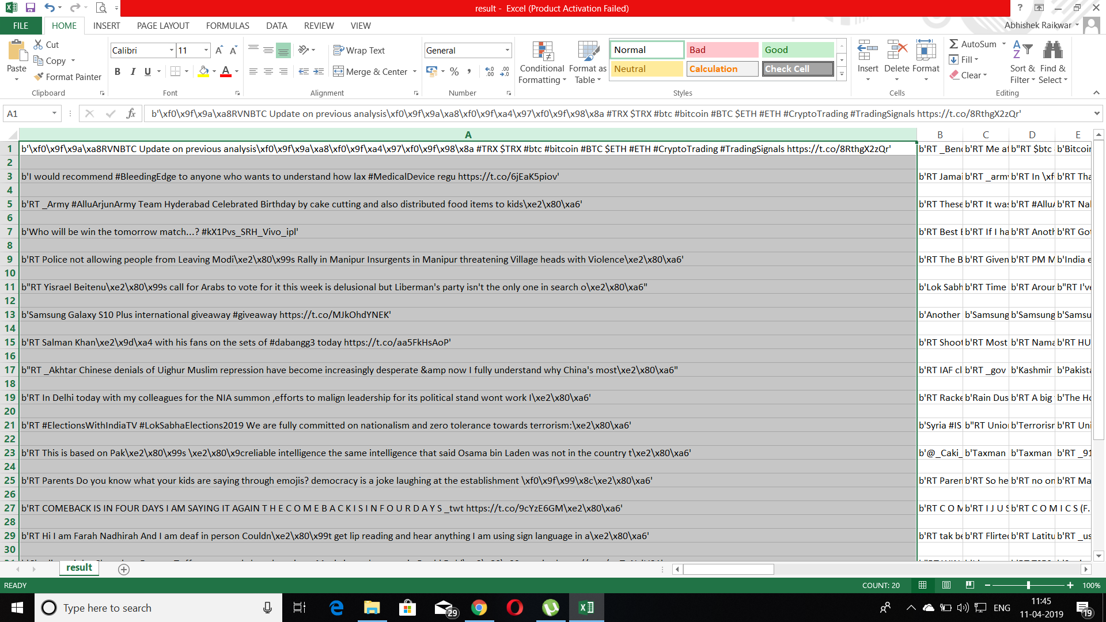

Slide 7
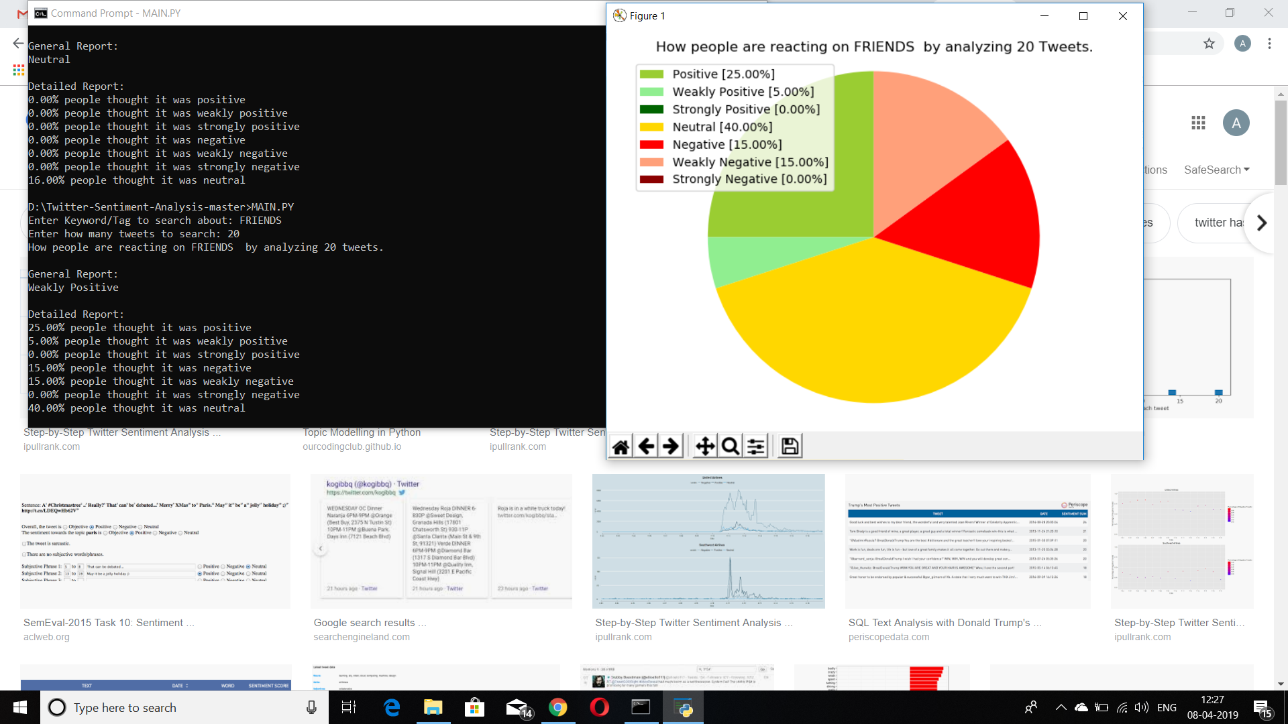

Slide 8
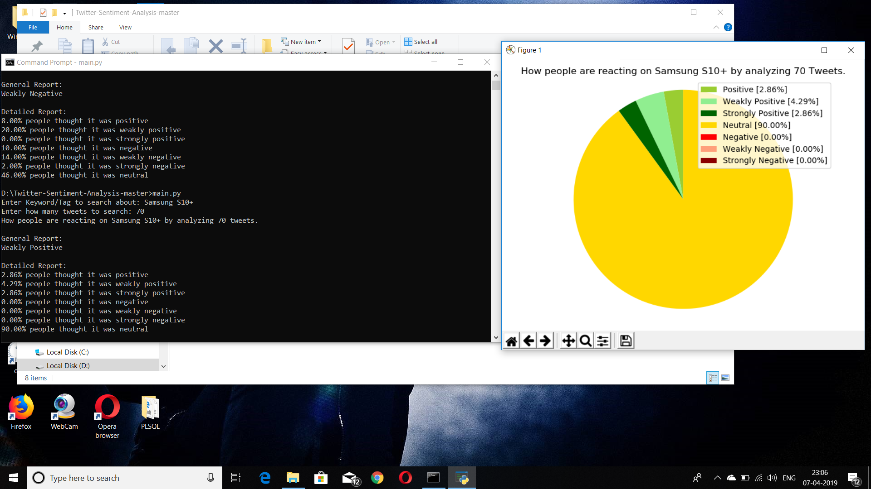

Slide 9
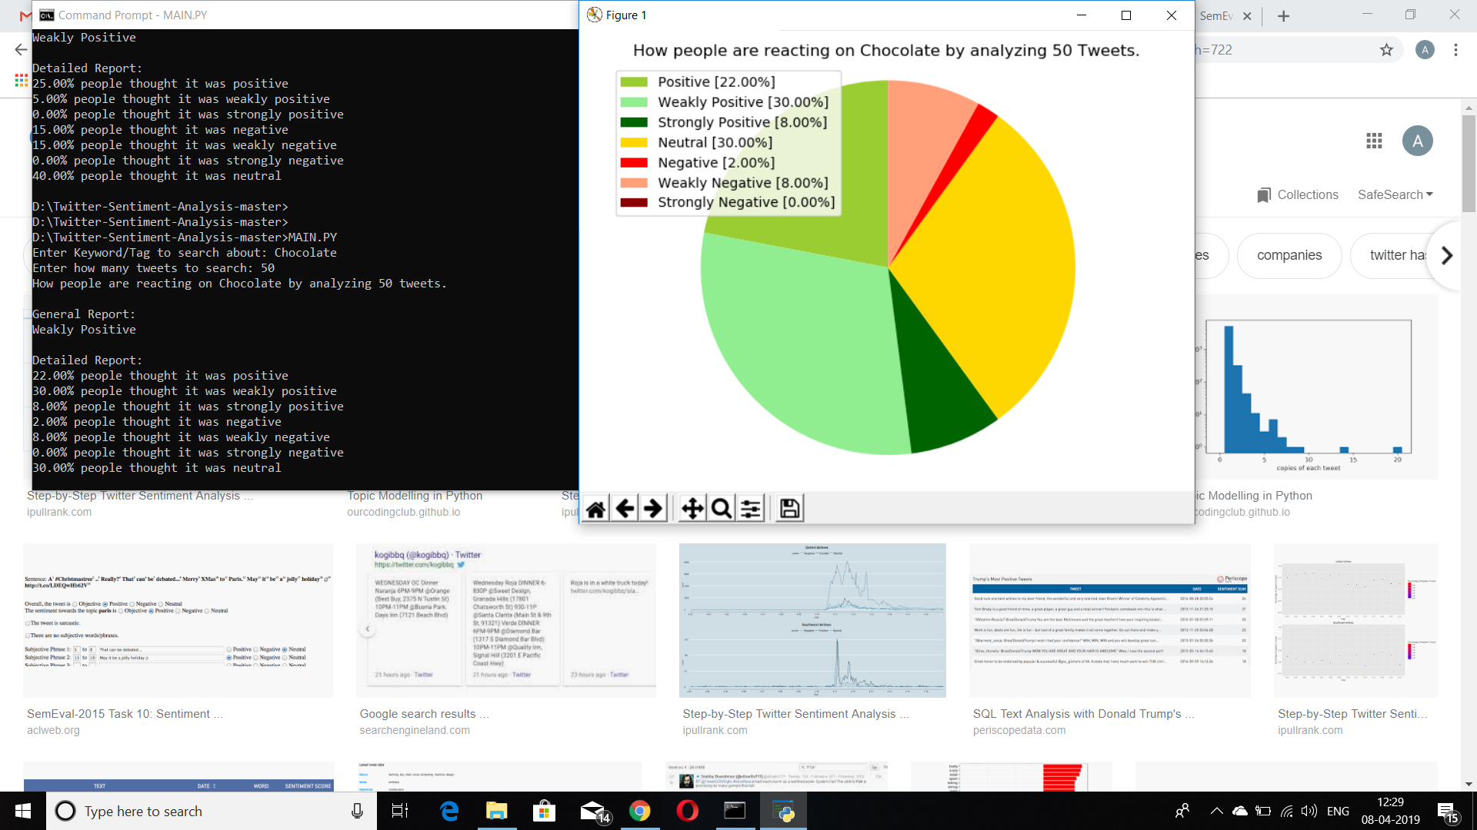

Slide 10
LIMITATIONS
● Pictorial representation is only in the form of pie charts.
● The human language can be complex for machine based learning systems to interpret. For example, opinions can be expressed with irony, and the order of words can add even more confusion.
● Only last 1 million tweets can be accessed.
● No twitter user information can be accessed

Slide 11
CONCLUSION
Sentiment analysis has become an important factor in decision making process in a particular field. Twitter is a source of vast unstructured and noisy data sets that can be processed to locate interesting patterns and trends. This project will provide prolific in extracting streams of data and has further classify it on based of location. Sentiment analysis, one cannot ignore the value that it adds to the industry. Because Sentiment analysis bases its results on factors that are so inherently humane, it is bound to become one the major drivers of many business decisions in future. Looking ahead, what we can see is a true social democracy that will be created. A democracy where every opinion counts and every sentiment affects decision making.

Slide 12


